Slide 1
Disciplines of engineering
BY: LOGAN BENNETT

Slide 2
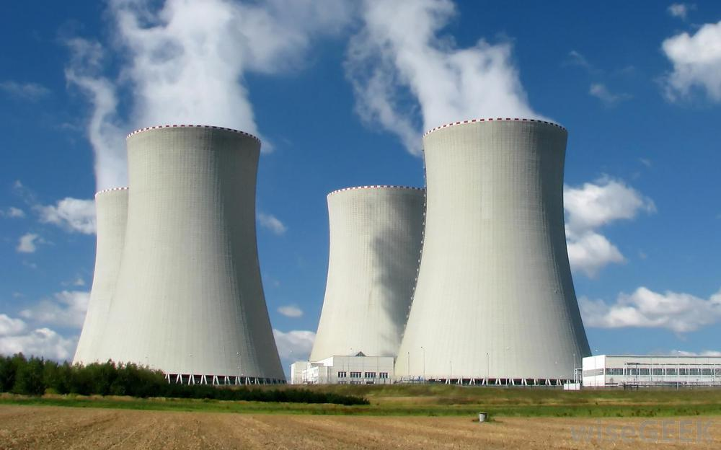
WHAT IS NUCLEAR ENGINEERING?
Nuclear engineering is the ”department” of engineering that directly works with nuclear power and other items on the atomic and nuclear levels. They solve problems such as creating the most energy in the best cost effective away and creating safer ways of nuclear power so the general public is not affected negatively. Nuclear engineering works electrical and chemical engineering as it uses many computer and electronic devices, but also works with many chemicals and elements.

Slide 3
Greatest achievement of the 20th century - computers
One of the greatest achievements of the 20th century was the invention of the computer. The computer is an essential item in modern life, almost everything we use has computers in it, your phone, television, printer, all have computers in them. The first electronic computer to be put into service was at Pennsylvania's Moore College of Electrical Engineering in 1946. It weighed 30 tons and consisted of 18,000 vacuum tubes, 6,000 switches, and 1,500 relays, and a new iPhone has better processing than it. Computers effect the way we live, how we live, and how every day tasks are accomplished. In addition to it being a large part of our lives, electrical engineering is almost 100% directly responsible for the creation of the computer. Computers are made out of circuits, processors, and other components, none of which would be here today if it was not for electrical engineering.

Slide 4
Grand achievement – fusion power
The grand achievement of “Fusion Power” is that we as humans can harness the power of the sun and its energy making process, known as fusion. Fusion power would allow limitless amounts of powerful energy to be generated on Earth allowing the whole planet to receive electrical power.
To create fusion power, many different types of scientists and engineers would be needed, one specific engineering type is nuclear engineering. Due to the fact that fusion power would be creating massive amounts of energy, a nuclear engineer, someone who has worked with nuclear power plants and the generation of energy on an enormous scale, would be needed to keep everything stable and in check. As well as nuclear engineers are the most capable in their field, allowing new points of view to be added so a better product can be created.

Slide 5
citations
My Engineering Notebook
http://bit.ly/1hKvaDT - Computer Information
http://bit.ly/1y27UuM - Fusion Power Information

