Slide 1
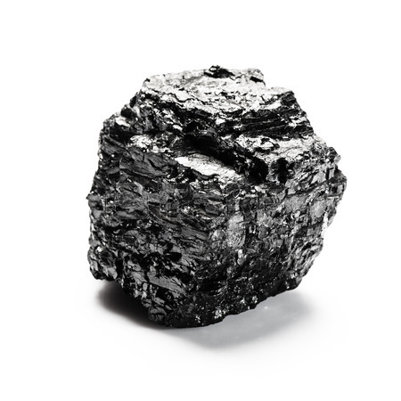
Coal
By: Logan B. and Nile H.

Slide 2
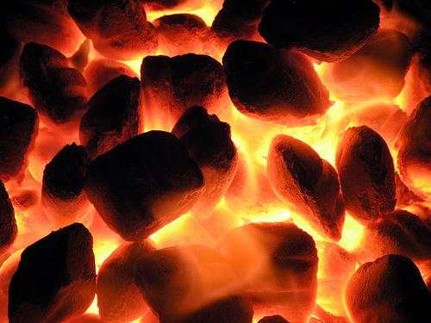
What is Coal?
Coal is a combustible black rock, made of mainly carbonized plant matter, found mainly in underground deposits and widely used as fuel.

Slide 3
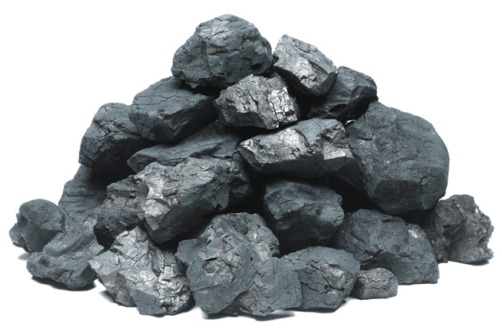
Renewable or Nonrenewable?
Coal is a nonrenewable resource. This mean that once use expend all of it that we have currently we won’t have anymore. At least not for millions of years. Since it is created by carbonized plant and animal remains from before the dinosaurs, it takes millennia to create it.

Slide 4
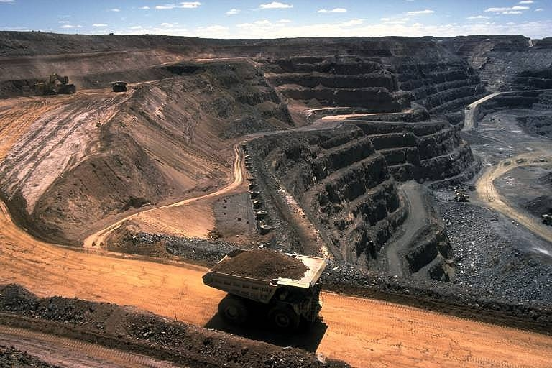
Where and how is it found?
Coal is a fossil fuel that was created millions of years ago and now can be used to generate electricity using modern day technology. Coal is gathered from mines and quarries (see picture below). Many mines around the world gather coal and it can be extremely dangerous. While mining, if a coal miner hits a rock wrong and a spark is created, it can cause massive explosions.
Fun fact
The truck in the picture is one of many which can pickup and
transport huge amounts of coal, One of the biggest trucks can
haul about 447 tons of coal

Slide 5
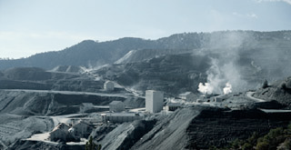
Environmental Effects
Although power plants are regulated by federal and state laws to protect health and the environment, there is a wide variation of environmental impacts associated with power generation technologies.
When coal is burned, carbon dioxide, sulfur dioxide, nitrogen oxides, and mercury compounds are released. For that reason, coal-fired boilers are required to have controllers to reduce the amount of emissions that are released.
Pollutants build up in the water used in the power plant boiler and cooling system. If the water used in the power plant is spilt or disposed of to a lake or river, the pollutants in the water can harm fish and plants. Also, if rain falls on coal stored in piles outside the power plant, the water that runs off these piles can wash off heavy metals from the coal, such as arsenic and lead, into nearby bodies of water. Coal mining can also contaminate bodies of water with heavy metals when the water used to clean the coal is sent back into the environment.

Slide 6
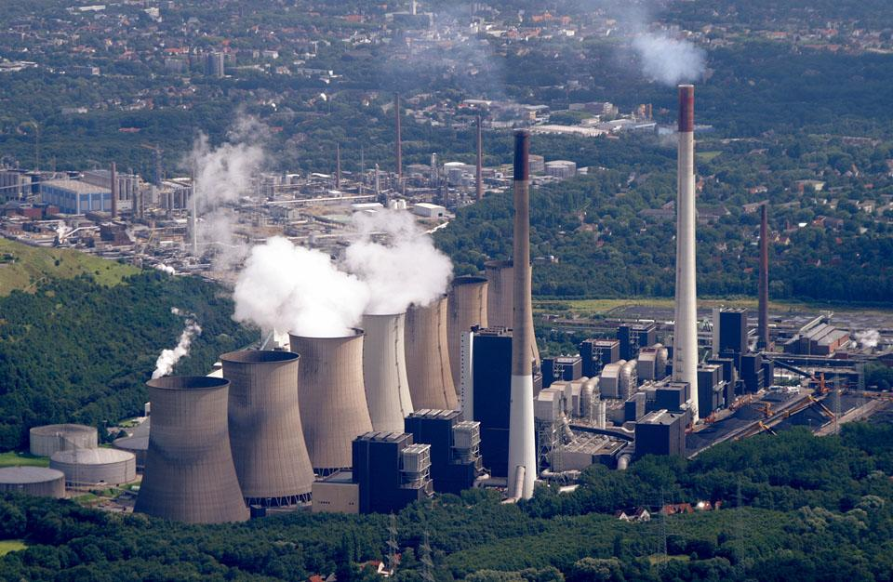
How Does Coal Power Work?
In a coal-fired steam station is much like a nuclear station, it makes water into steam, which in turn drives turbine generators to produce electricity. Here’s how that works:
1. Heat is created
Before the coal is burned, it is pulverized into the density of talcum powder. It is then mixed with hot air and blown into the firebox of the boiler. Burning in suspension, the coal/air mixture provides the most complete combustion and maximum heat possible.
2. Water turns to steam
Highly purified water, pumped through pipes inside the boiler, is turned into steam by the heat. The steam reaches temperatures of up to 1,000 degrees Fahrenheit and pressures up to 3,500 pounds per square inch, and is piped to the turbine.
3. Steam turns the turbine
The enormous pressure of the steam pushing against a series of giant turbine blades turns the turbine shaft. The turbine shaft is connected to the shaft of the generator, where magnets spin within wire coils to produce electricity.
4. Steam turns back into water
After doing its work in the turbine, the steam is drawn into a condenser, a large chamber in the basement of the power plant. In this important step, millions of gallons of cool water from a nearby source (such as a river or lake) are pumped through a network of tubes running through the condenser. The cool water in the tubes converts the steam back into water that can be used over and over again in the plant.

Slide 7
Citations
http://www.eschooltoday.com/energy/non-renewable-energy/what-is-coal.html
https://www.duke-energy.com/about-energy/generating-electricity/coal-fired-how.asp
http://www.epa.gov/cleanenergy/energy-and-you/affect/coal.html
http://www.theinnovationdiaries.com/2494/where-does-coal-come-from/
http://images.bwbx.io/cms/2012-04-26/econ_coal18__01__630x420.jpg
https://emergingequity.files.wordpress.com/2015/02/coal-1.jpg
https://upload.wikimedia.org/wikipedia/commons/7/72/Coal_anthracite.jpg
http://theamericanenergynews.com/wp-content/uploads/2015/07/Coal-Fired-Power-Plant.jpg

